Slide 1


Web Development Project Proposal
Course: CSE242
Subtitle: Three Practical Web App Ideas
Instructor: Promila Hoque
20 October 2025
PRESENTED BY:
Syed Nazmus Sakib
233028312
Misbah Uddin
233022312
Mohammed Shafkatul Alam
233030712
MD. Sadman
233027612

Slide 2

About the Proposal
💡 Purpose Present three unique, practical, and doable full-stack web app ideas. Demonstrate understanding of frontend, backend and database development.
🧱 Requirements Each idea includes: Website features and functions Chosen frontend, backend, and database technologies Mention of UI/UX design tools (Figma) if used Projects are realistic to build within the semester.

Slide 3
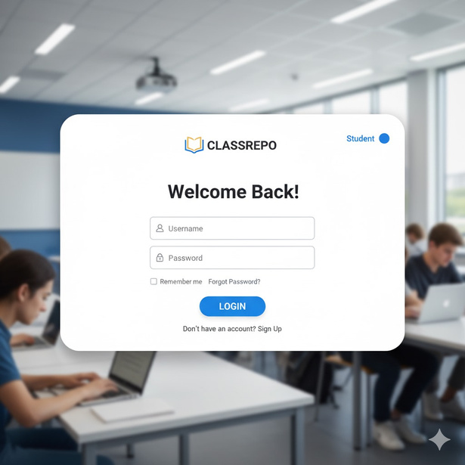
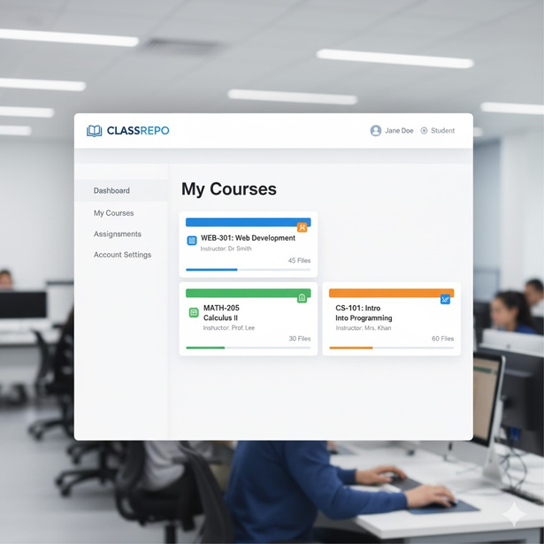
Idea 1: EDU Classroom Repo
Description: Current and Previous students enrolled shares the course materials, lecture notes of different faculties under their classroom.
Features:
  File Upload & Download
  Role-Based Access (Admin, Teacher, Student)
  Visual Suggestion: File upload illustration, classroom icons.
  Access to their own departments

Slide 4
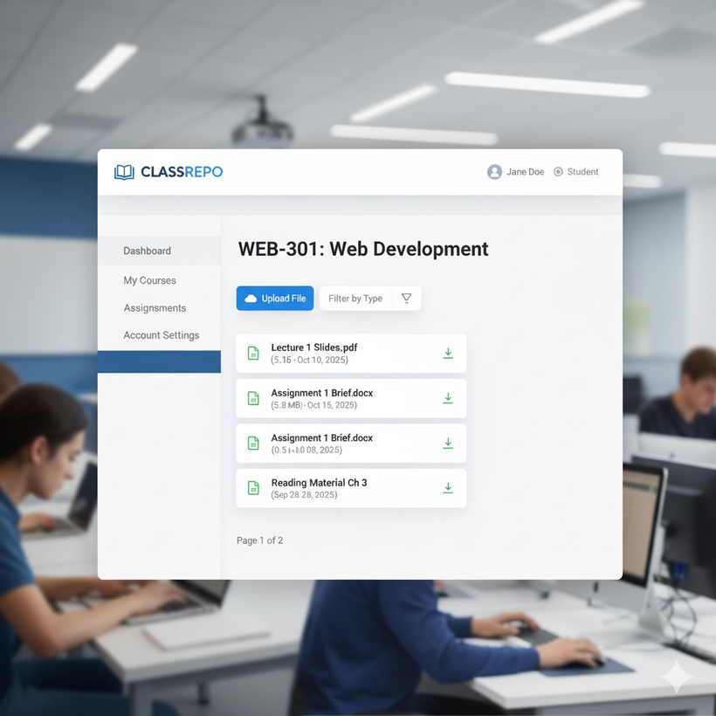
Tech Stack & Why It Fits
Frontend: HTML, CSS, Javascript, React.js
Backend: Node.js (Express)
Database: MongoDB
UI/UX: Figma (if needed to optimize)
Why It Fits:
CRUD, file handling, access control, perfect academic relevance.

Slide 5

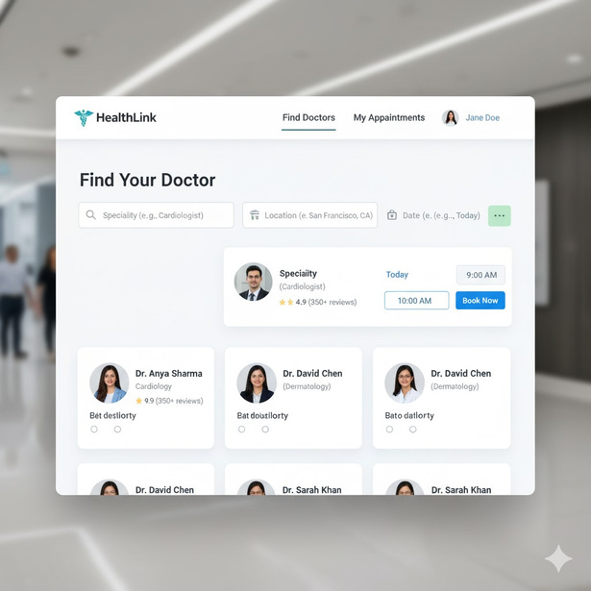
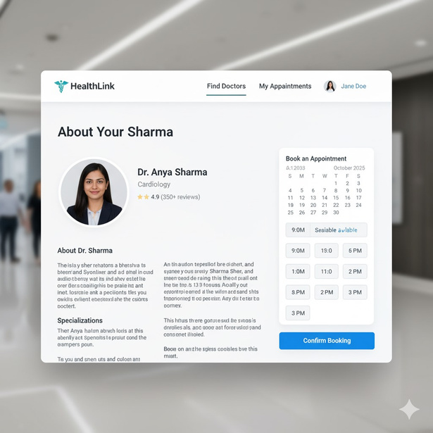
Idea 2: HealthLink
Description: A web platform for booking and managing doctor appointments online.
Features:
  Doctor & Patient Login
  Informations of Different Doctors
  Appointment Booking & Rescheduling
  Admin Control over Doctor Schedules
  Email or SMS Notifications

Slide 6
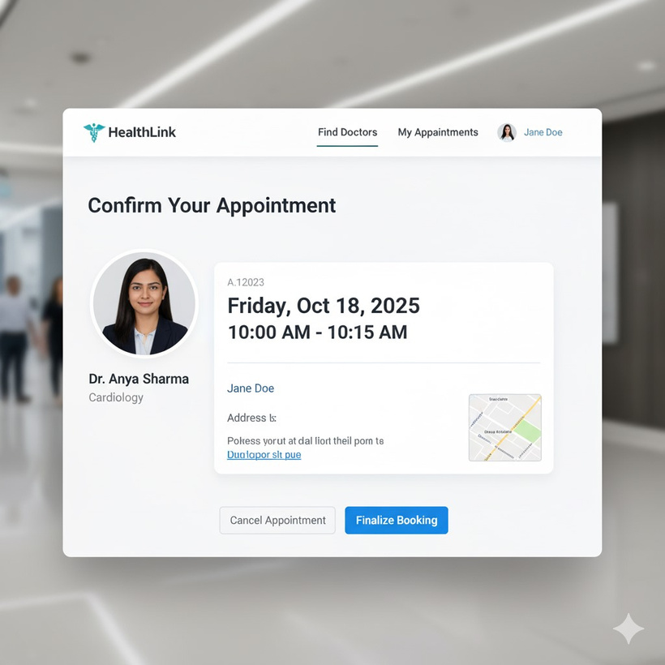
Tech Stack & Why It Fits
Frontend: HTML, CSS, Javascript, React.js
Backend: Node.js (Express) / Django
Database: MongoDB / SQLite
UI/UX: Figma (if needed)
Why It Fits:
CRUD operations, real-world medical use, strong database integration.

Slide 7
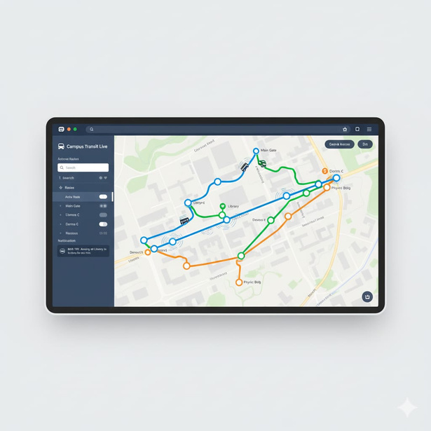
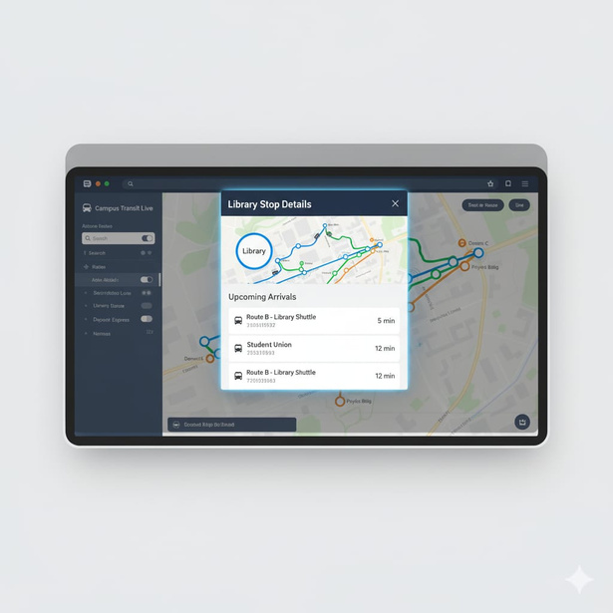
Idea 3: EDU Bus Tracker
Description: Help student track the live location of the university buse and catch the closest bus enroute.
Features:
  Real-Time Bus Location
  Student Login (University Email)
  Admin Control for Routes & Timings
  Push Notifications for Bus Arrival

Slide 8
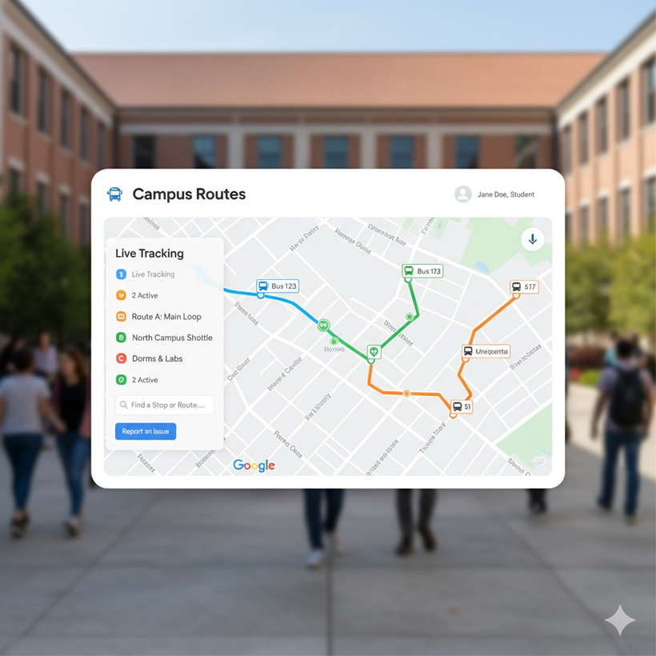
Tech Stack & Why It Fits
Frontend: React.js
Backend: Python Django
Database: MongoDB
Map Integration: Google Maps API
UI/UX: Figma
Why It Fits:
Live data, API integration, scalable and highly useful for students

Slide 9
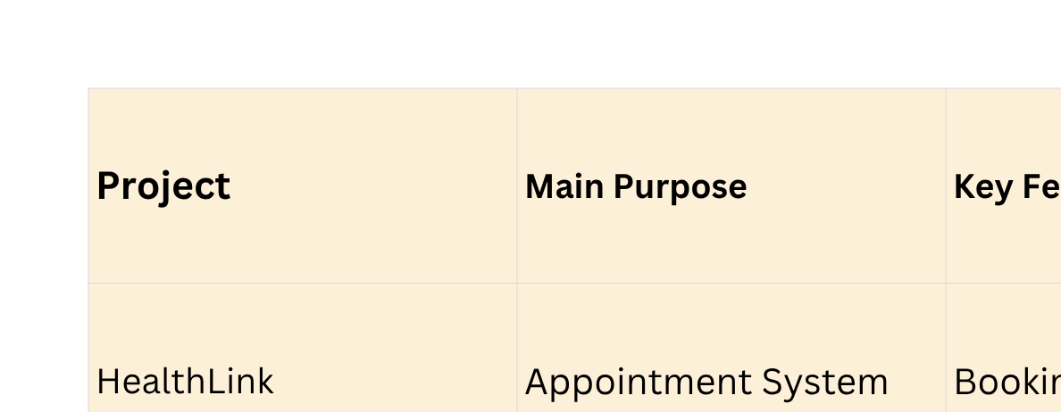
Summary Comparison Table

Slide 10
Conclusion
Thank you for your time.
We would love an recommendations from the faculty and the ones viewing our presentation.
Our Email IDs:
Syed Nazmus Sakib
233028312@eastdelta.edu.bd
Mohammed Shafkatul Alam
233030712@eastdelta.edu.bd
Misbah Uddin
233022312@eastdelta.edu.bd
MD. Sadman
233027612@eastdelta.edu.bd

